Slide 1
연구 성과 및 향후 연구 계획
국립농업과학원 유전체과
김진현
‘20.02.25
1/28

Slide 2
목 차
I. 연구 배경
II. 연구 방법 & 연구 결과
III. 향후 계획
2/28

Slide 3
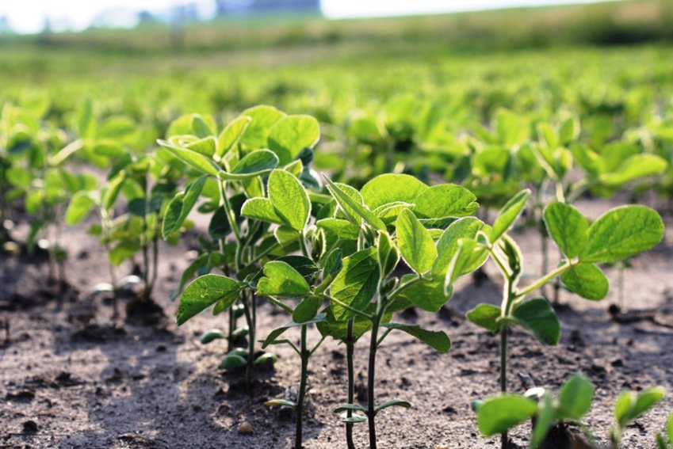
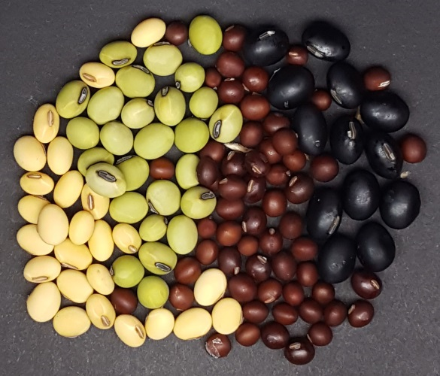
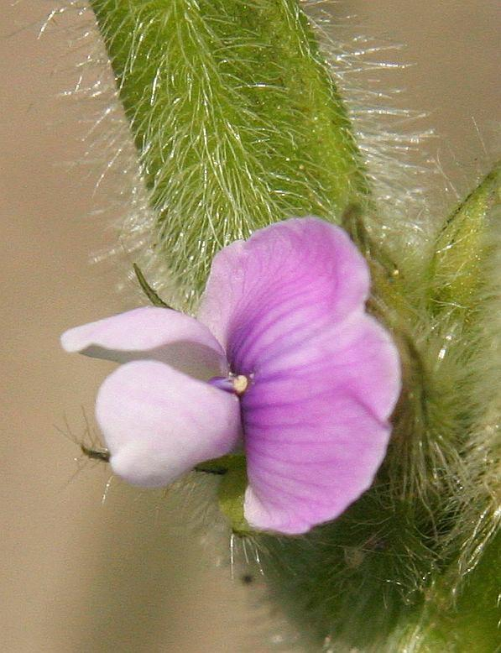
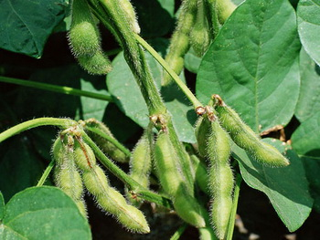
Soybean (Glycine max)
Important source of protein and oil
Soybean produces numerous health-promoting phytochemicals
Anthocyanin, isoflavonoid, oilgosaccharide, saponin …
Anthocyanins are the key components abundant in dark colored soybean seeds
Effective antioxidants attracting attention from the beauty industry and for medicinal uses
The colors of seed coat are also related to the storability of seeds
3/28

Slide 4
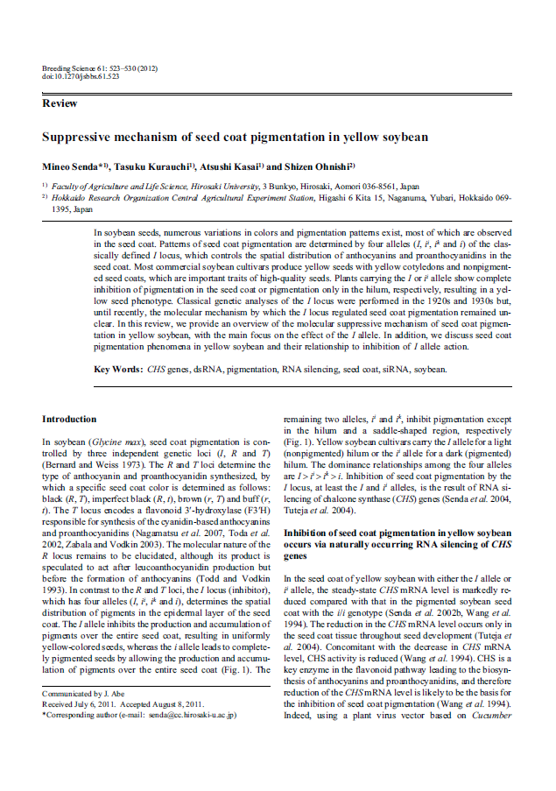
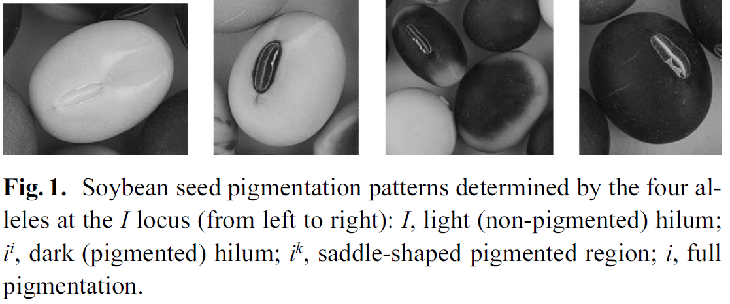


Four alleles (I, i^{i}, i^{k}, i) at the I locus
2011
Inhibitor Locus
I
$$i^{i}$$
$$i^{k}$$
i
Senda, M., Kurauchi, T., A., & Ohnishi, S, (2011). Suppressive mechanism of seed coat pigmentation in yellow soybean. Breeding Science, 61 (5), 523-530
4/28

Slide 5
Anthocyanin biosynthetic pathway in plants
4-coumaroyl-CoA + 3 x malonyl-CoA
CHS
RNAi
I
Naringenin chalcone
CHI
Naringenin
F3H
Dihydromyricetin
F3'5'H
Dihydrokaempferol
F3'H
Dihydroquercetin
DFR
DFR
DFR
Leucodelphinidin
Leucopelargonidin
Leucocyanidin
LAR
ANS
ANS
ANS
Delphinidin
pelargonidin
Cyanidin
ANR
Flavan-3-ols
epicatechin
UF3GT
UF3GT
UF3GT
Delphinidin-3-glucoside
Pelargonidin-3-glucoside
Cyanidin-3-glucoside
TANNINS
~70% C3G
Anthocyanins
Proanthocyanidins
5/28

Slide 6
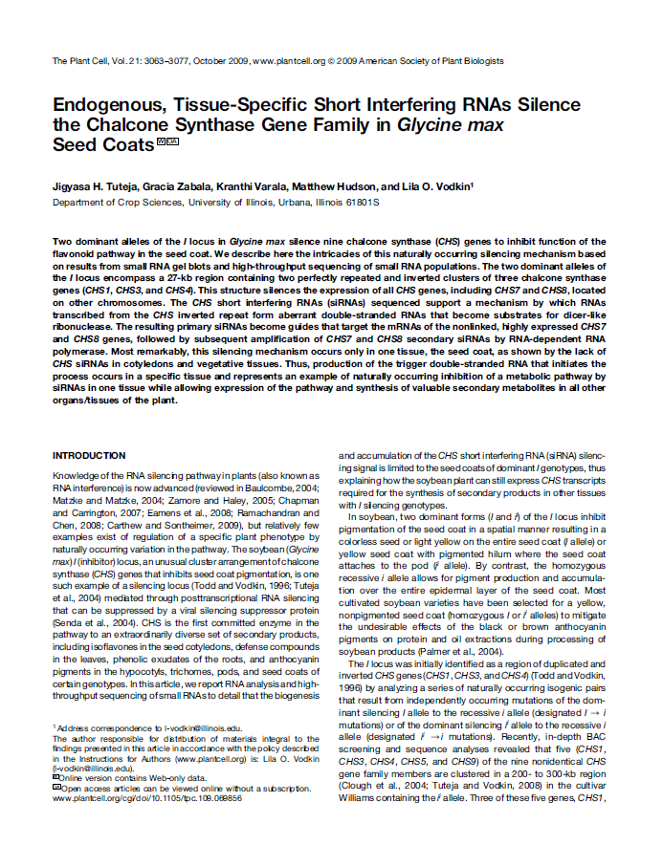
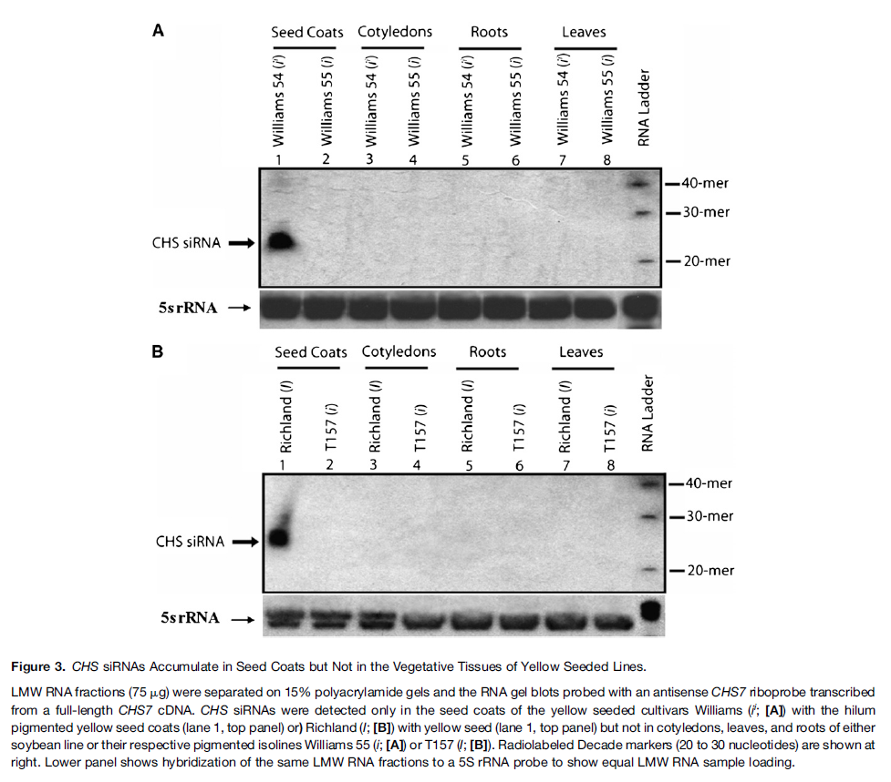
Tissue-specific siRNAs silence the CHS genes
2009
Tuteja, J. H., Zabala, G., Varala, K., Hudson, M., & Vodkin, L. O. (2009). Endogenous, tissue-specific short interfering RNAs silence the chalcone synthase gene family in glycine max seed coat. Plant Cell, 21(10), 3036-3077.
6/28

Slide 7
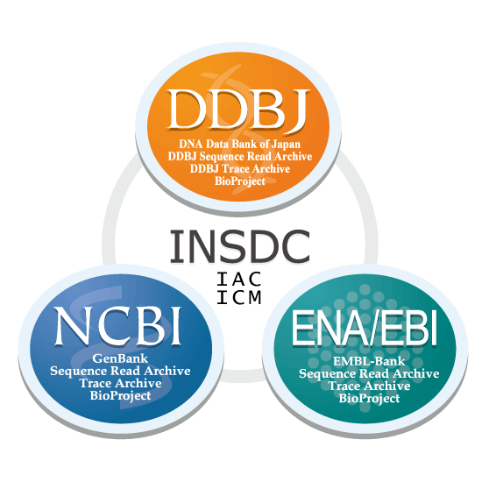
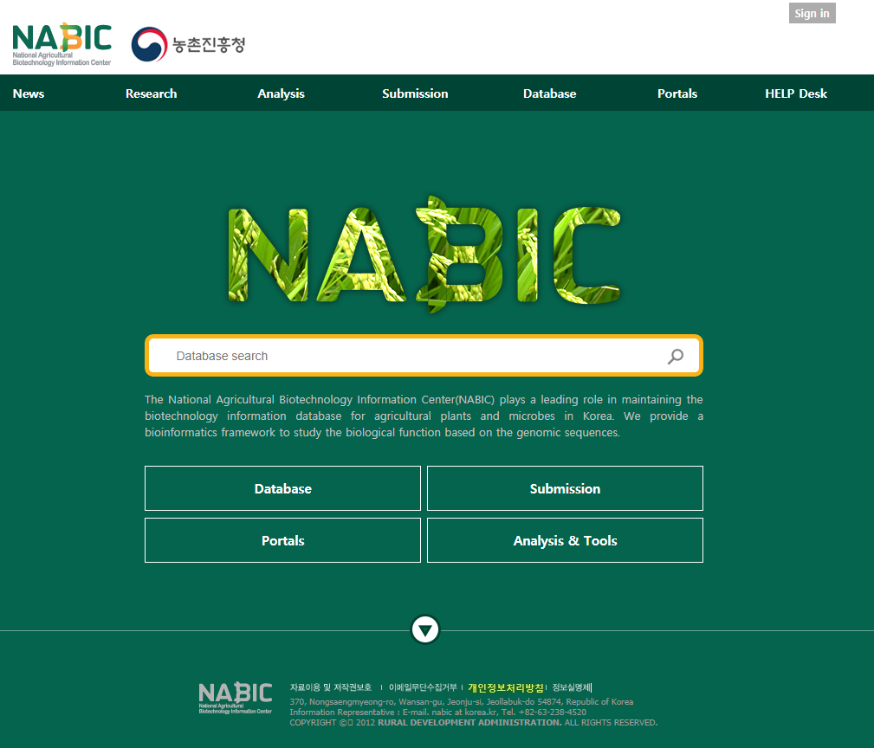
National Agricultural Biotechnology Information Center
NGS data collection
1
동아대학교 식물유전체학 실험실 (DAU)
Sample 43개
2
3
International Nucleotide Sequence Database Collaboration (INSDC)
National Agricultural Biotechnology Information Center (NABIC)
Sample 662개
Sample 121개
1
2
3
826개
Mapping rate 80% 이상
739개
7/28

Slide 8

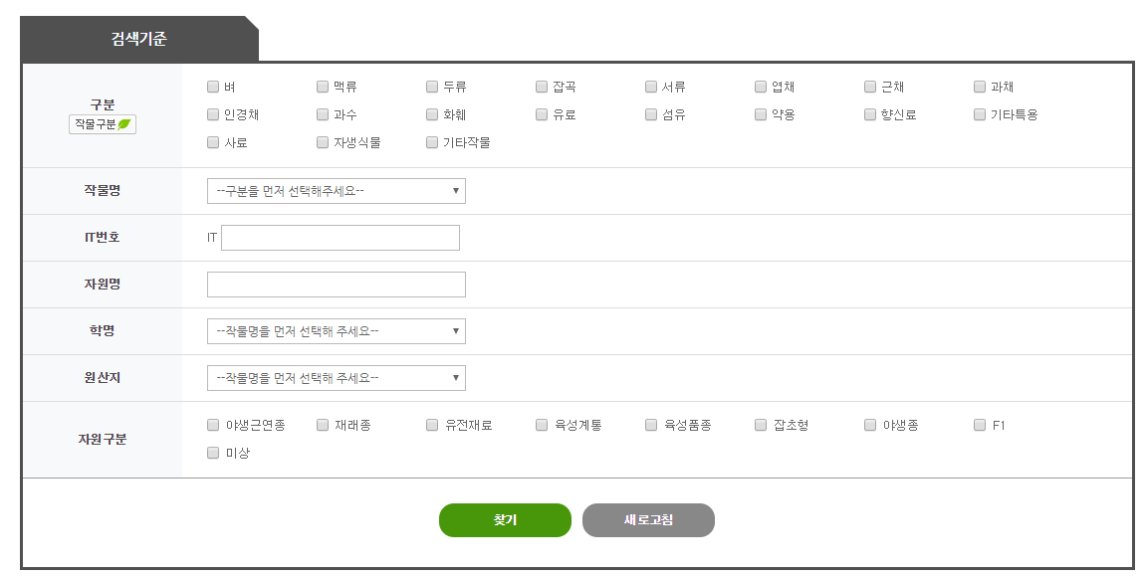
Phenotype data collection
739개
1
USDA GRIN
PI number
(Plant ID)
Phenotype 유무
https://npgsweb.ars-grin.gov/gringlobal/search.aspx?
438개
2
농업유전자원센터
(
)
IT number
(Introduction)
DAU : 43 → 43
INSDC : 662 → 302
http://genebank.rda.go.kr/simpleSearch.do
NABIC : 121 → 93
3
농사로, 관련 논문, 품종 해설집, ...
8/28

Slide 9
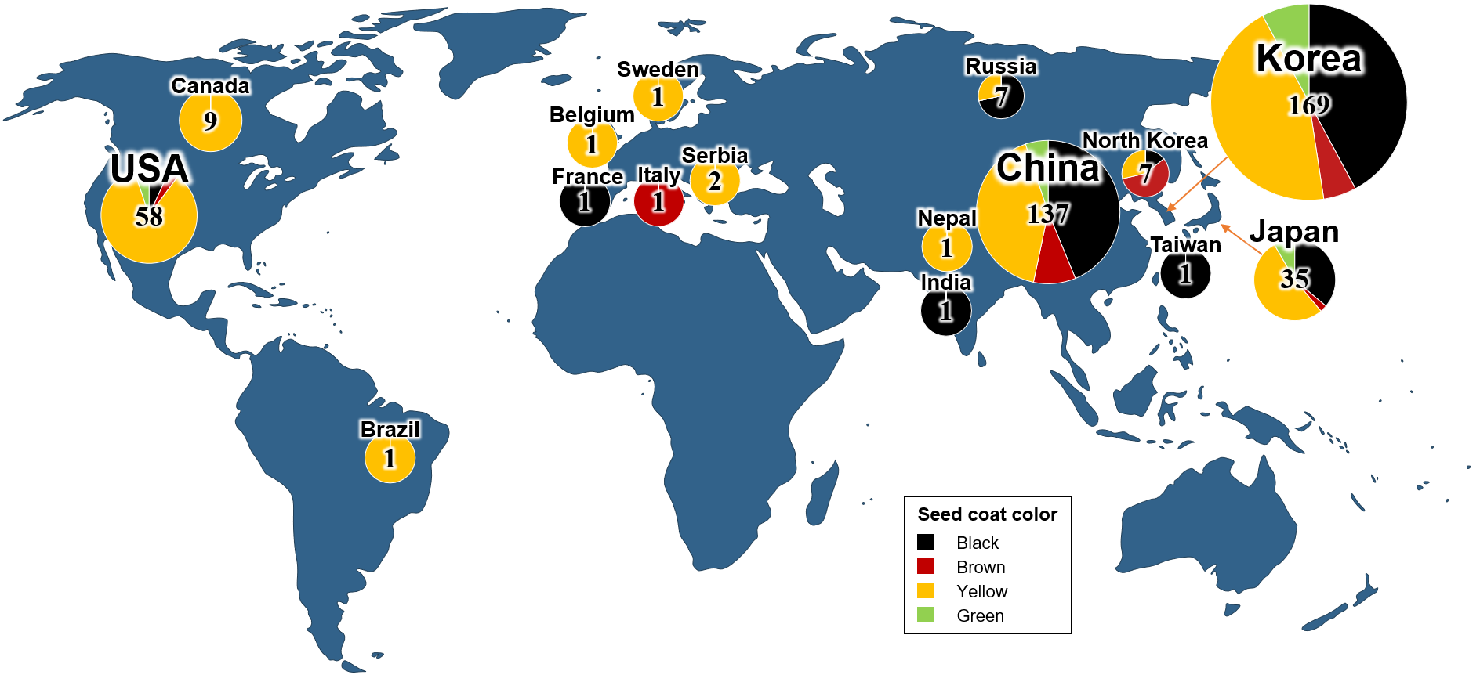
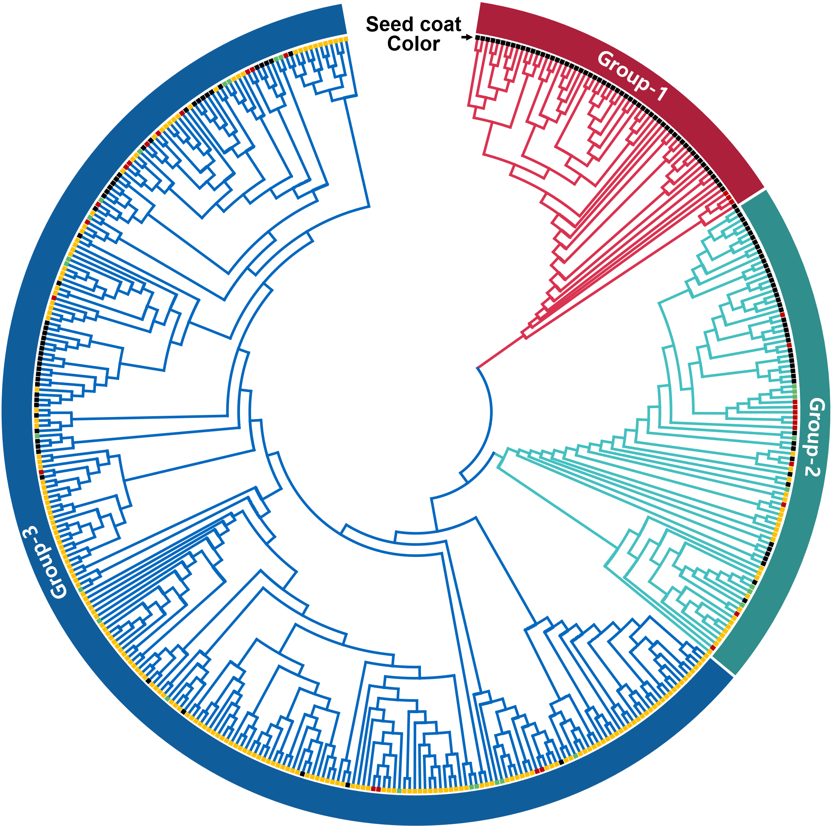
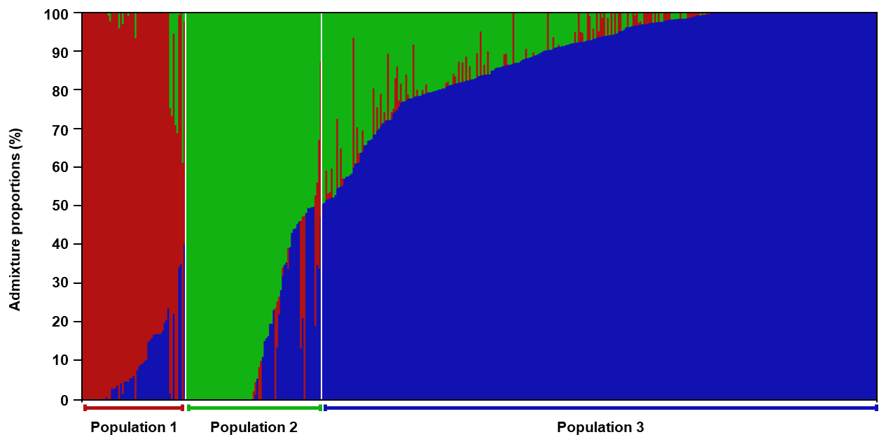
Geographic, genetic and phenotypic diversity
A
C
Glycine soja
97.19%
B
99.15%
98.15%
Glycine max (Group-2, 3)
9/28

Slide 10












Schematic of the genetic interactions (I, T locus)
, and expected phenotypes
I Locus
T Locus
Expected phenotype
211
154
vs
I
t
(99)
I
$$i^{i}$$
$$i$$
$$i$$
$$i^{i}$$
t
(38)
105
154
$$i$$
t
vs
I
T
(7)
$$i$$
$$i$$
$$i^{i}$$
$$i^{i}$$
T
(67)
67
154
$$i$$
T
(154)
vs
(No. of accessions)
Seed coat & hilum
Pubescence
$$i^{i}$$
$$i$$
Hilum
$$X$$
Allele
Black
Tawny
Seed coat
Pubescence
Yellow
Gray
Irrelevance
Irrelevance
10/28

Slide 11
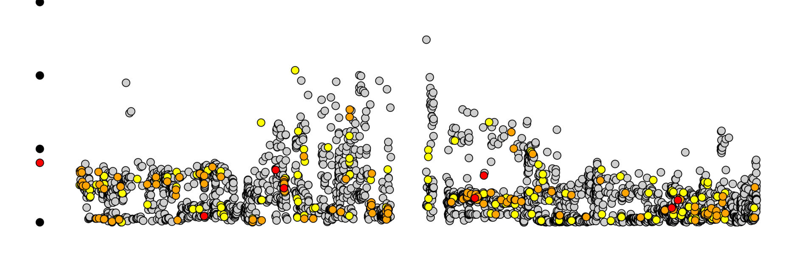
Large unsequenced region found around I locus
20
-log₁₀(P value)
1
2
3
4
5
6
7
8
9
10
11
12
13
14
15
16
17
18
19
20
0
Chromosome
sequenced region
sequenced region
NNNNN…NNNNN
SnpEFF Impact*
30
High
Moderate
Low
Modifier
20
-log₁₀(P value)
10
0
8.2
8.3
8.4
8.5
8.6
8.7
8.8
Chromosome 8 (Mb)
Chalcone synthase
*Putative functional impact of variant that is defined by SnpEff
11/28

Slide 12
Mapping-based Variant Calling
Mapping-based Variant Calling
NGS read
Reference
(A→G)
Sample 1
A/A
Sample 2
A/G
Sample 3
G/G
12/28

Slide 13
Kmer-based Variant Calling
Mapping-based Variant Calling
NGS read
Reference
(A→G)
Sample 1
A/A
Sample 2
A/G
Sample 3
G/G
Kmer-based Variant Calling
Sample 1
4개
A/A
A/A
0개
31mer
Sample 2
2개
A/G
A/G
2개
31mer
Sample 3
0개
G/G
G/G
4개
13/28

Slide 14
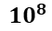
1억 =
$${10}^{8}$$
Kmer-based Variant Calling
Glycine max : 978495272 bp = $9.78495272 ×{10}^{9}$
5-mer : 0/955311423 = 0.00%
31-mer : 620696674/954864587 = 65.00%
50-mer : 728122179/954864587 = 78.47%
14/28

Slide 15
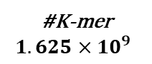
Kmer-based Variant Calling Result
#Accessions
438
kmerIDX | Kmer sequence | B08F | B10F | B04F | B01F | B06F | B14F | B15F | B03F
0 | TTGAAAAAAAAAAAAAAAAAAAAAAAAAAAA | 139 | 46 | 111 | 144 | 150 | 200 | 190 | 185
1 | TTGAAAAAAAAAAAAAAAAAAAAAAAAACAA | 0 | 0 | 3 | 5 | 4 | 12 | 9 | 10
2 | TTGAAAAAAAAAAAAAAAAAAAAAAAACAAA | 4 | 2 | 2 | 4 | 2 | 13 | 10 | 10
3 | TTGAAAAAAAAAAAAAAAAAAAAAAAACCAA | 0 | 0 | 0 | 0 | 0 | 0 | 0 | 0
4 | TTGAAAAAAAAAAAAAAAAAAAAAAAAGAAA | 5 | 0 | 3 | 8 | 0 | 7 | 2 | 10
5 | TTGAAAAAAAAAAAAAAAAAAAAAAAAGCAA | 0 | 0 | 0 | 0 | 2 | 2 | 2 | 3
6 | TTGAAAAAAAAAAAAAAAAAAAAAAAATAAA | 5 | 0 | 3 | 3 | 4 | 3 | 11 | 4
7 | TTGAAAAAAAAAAAAAAAAAAAAAAAATCAA | 0 | 0 | 0 | 0 | 0 | 0 | 0 | 0
8 | TTGAAAAAAAAAAAAAAAAAAAAAAACAAAA | 4 | 2 | 5 | 2 | 5 | 10 | 2 | 5
9 | TTGAAAAAAAAAAAAAAAAAAAAAAACACAA | 0 | 0 | 0 | 0 | 0 | 4 | 2 | 0
10 | TTGAAAAAAAAAAAAAAAAAAAAAAACCAAA | 0 | 0 | 0 | 0 | 0 | 2 | 0 | 0
11 | TTGAAAAAAAAAAAAAAAAAAAAAAACCCAA | 0 | 0 | 0 | 0 | 0 | 0 | 0 | 0
12 | TTGAAAAAAAAAAAAAAAAAAAAAAACGAAA | 0 | 0 | 0 | 0 | 0 | 0 | 0 | 0
13 | TTGAAAAAAAAAAAAAAAAAAAAAAACTAAA | 0 | 0 | 0 | 0 | 0 | 0 | 0 | 0
14 | TTGAAAAAAAAAAAAAAAAAAAAAAACTCAA | 0 | 0 | 0 | 0 | 0 | 0 | 0 | 0
15 | TTGAAAAAAAAAAAAAAAAAAAAAAAGAAAA | 3 | 0 | 2 | 7 | 0 | 11 | 2 | 5
16 | TTGAAAAAAAAAAAAAAAAAAAAAAAGACAA | 0 | 0 | 0 | 0 | 0 | 2 | 0 | 2
17 | TTGAAAAAAAAAAAAAAAAAAAAAAAGCAAA | 0 | 0 | 0 | 0 | 0 | 0 | 0 | 0
...
#K-mer
$$1.625×{10}^{9}$$
...
15/28

Slide 16
Data consistency of genotypes between mapping and Kmer-based variant calling
G-Locus
Seed coat color [Green/Yellow]
53229579
Chr01 : 53229579 A -> G
Green
53229549 TTGGGTTTGAACTAATTTGTCTTTTTGTTTAGAATGGTTACGTGACAGACTGATAATATTC 53229609
Yellow
53229549 TTGGGTTTGAACTAATTTGTCTTTTTGTTTGGAATGGTTACGTGACAGACTGATAATATTC 53229609
A/A
A/G
G/G
Mapped-based
Green
7
1
20
Yellow
216
4
0
A/A
A/G
G/G
Kmer-based
Green
7
1
20
Yellow
215
4
0
99.54% 일치
16/28

Slide 17




Identification of a unique k-mer
Significantly associated with i^{i} locus
$$i^{i}$$
T
(67)
$$i$$
T
(154)
K-mer^{i} : ATGTCAATAAGATAAGTATATTGTAAAATGG
$$i$$
$$i^{i}$$
Presence
2
64
Absence
152
3
17/28

Slide 18
Discovering a genomic structural change
G. soja (PI483463) : Gs08
Serine hydroxymethyltransferase 2
Subtilisin
8,506,018
8,521,018
Recombination event
8,627,147
I-cluster B
8,612,149
CHS4
CHS3
CHS1
CHS5
G. max (Williams 82) : BAC77G7-a
K-mer^{i}: ATGTCAATAAGATAAGTATATTGTAAAATGG
45,000
I-cluster B
60,000
CHS4
CHS3
CHS1
Cleaved subtilisin
G. max (Williams 82) : BAC77G7-a
I Cluster A
I Cluster B
CHS1
CHS3
CHS4
CHS4
CHS3
CHS1
Subtilisin
18/28

Slide 19
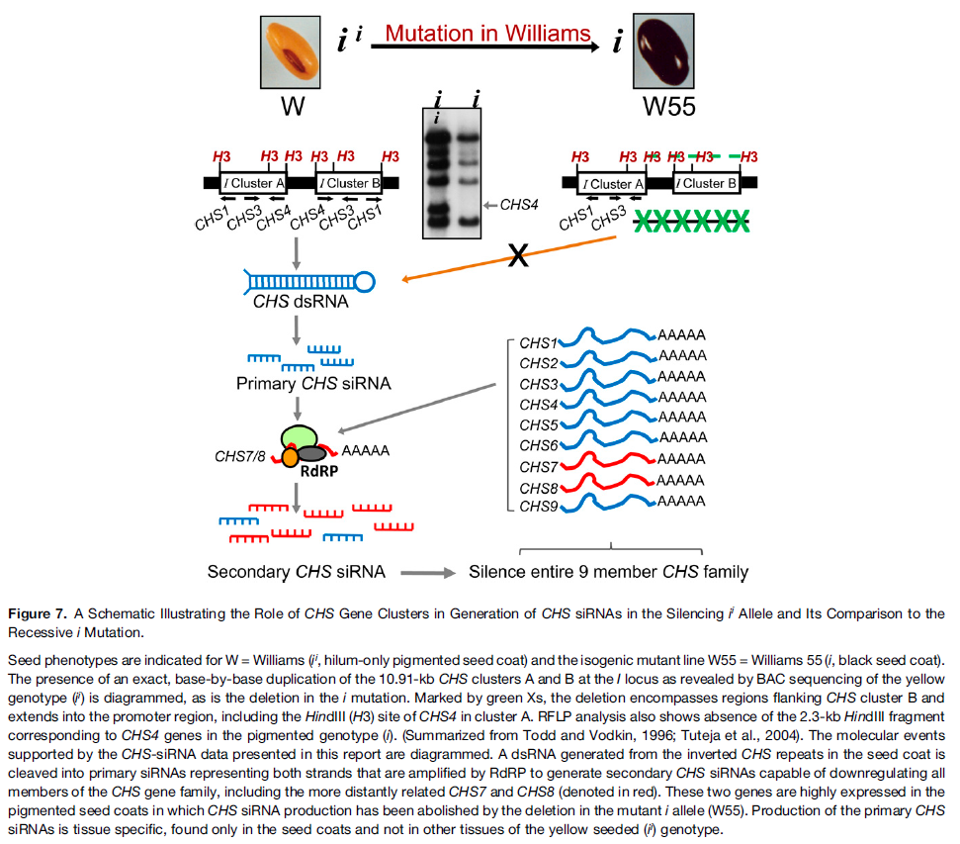
Tissue-specific siRNAs silence the CHS genes
I Cluster A
I Cluster B
CHS1
CHS3
CHS4
CHS4
CHS3
CHS1
Subtilisin
Tuteja, J. H., Zabala, G., Varala, K., Hudson, M., & Vodkin, L. O. (2009). Endogenous, tissue-specific short interfering RNAs silence the chalcone synthase gene family in glycine max seed coat. Plant Cell, 21(10), 3036-3077.
19/28

Slide 20


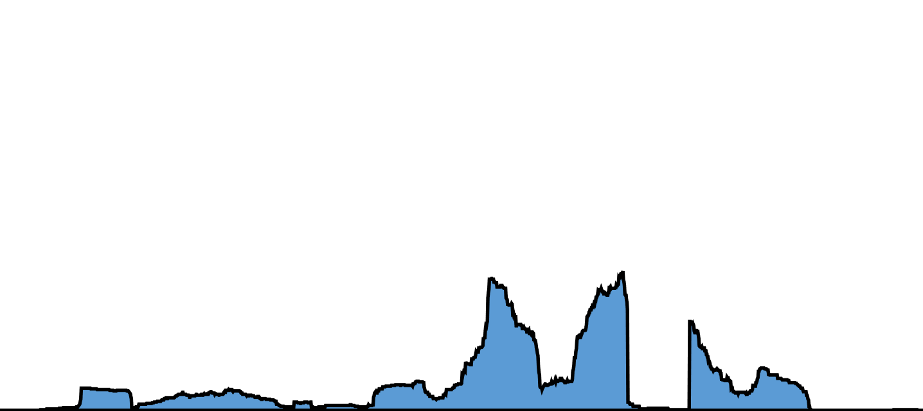
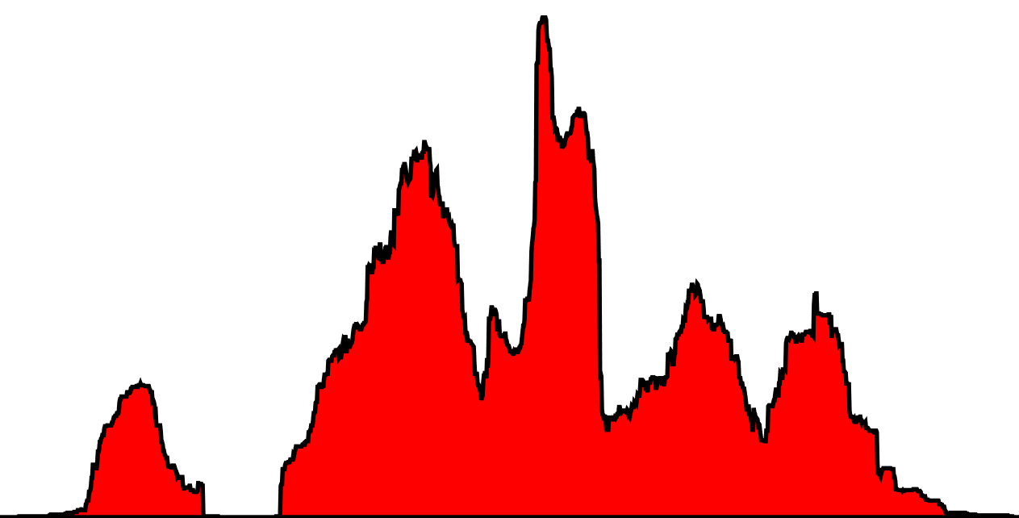






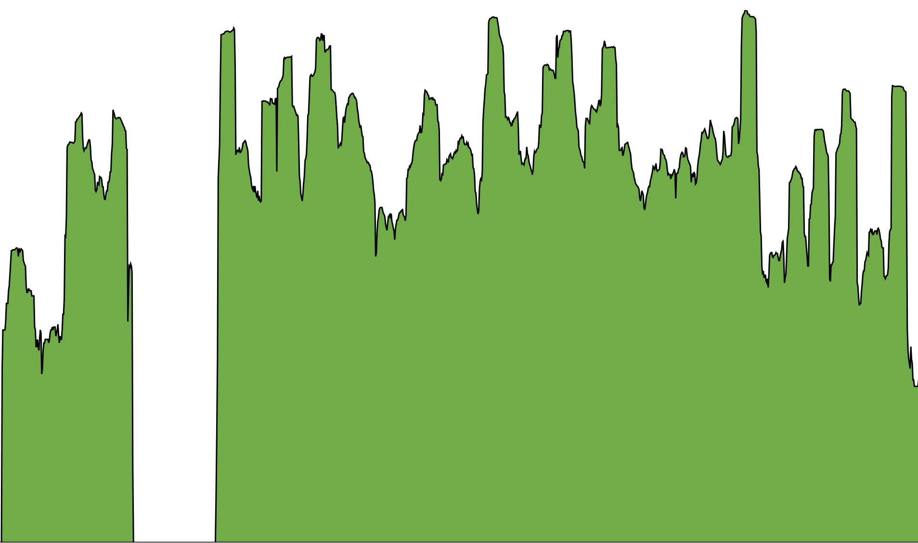
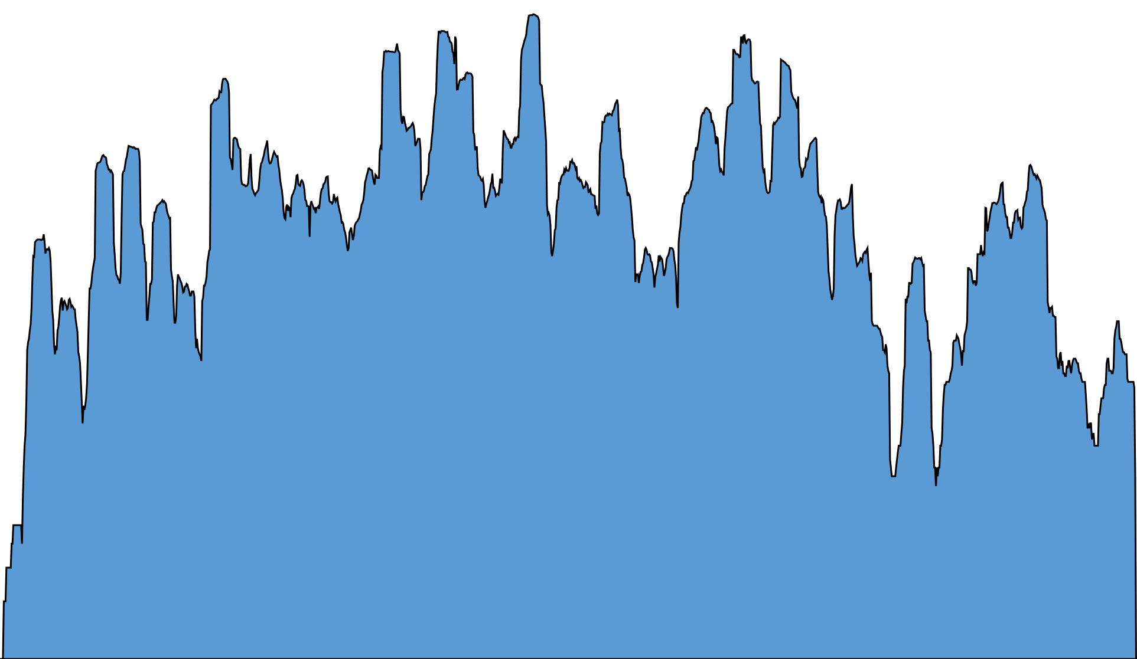
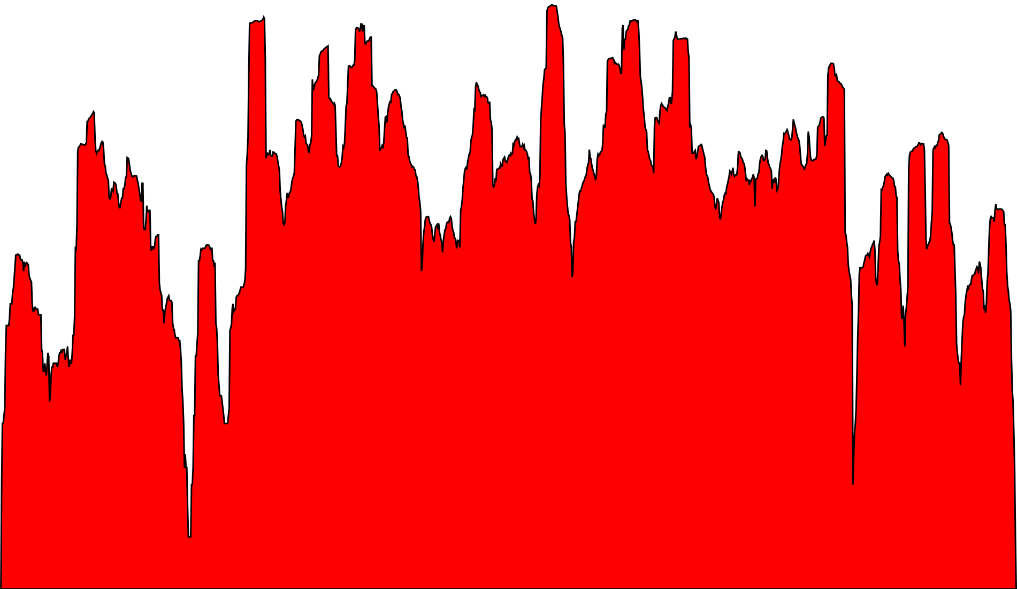
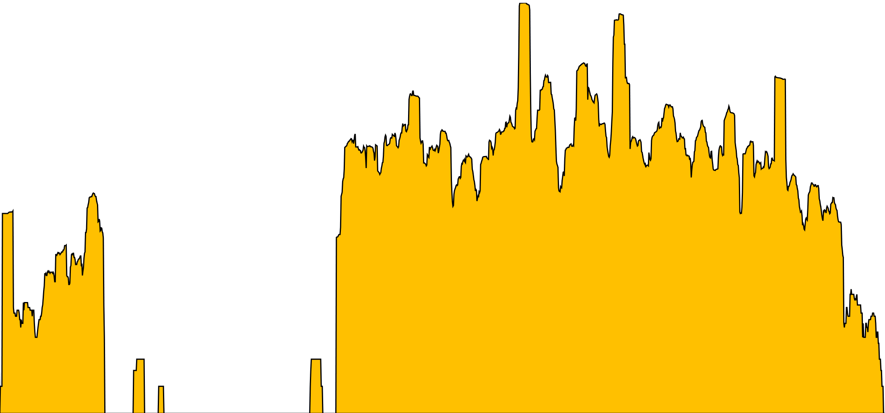
RNA-seq and small RNA-seq
A
CHS4
CHS3
CHS1
Gene expression in root
600
400
200
Depth
I-cluster B
0
CHS4
CHS3
CHS1
Cleaved subtilisin
BAC77G7-a
0
20
40
60
Chimeric subtilisin-CHS1/CHS3
Gene expression in seed coat
B
1000
Read Depth
100
10
0
1000
Read depth
100
10
0
CHS4
I-cluster B
CHS3
CHS1
Cleaved subtilisin
44
46
48
50
52
54
56
58
BAC77G7-a (Kbp)
C
10000
1000
Read Depth
100
10
0
10000
Read depth
100
0
CHS7
55,646
55,648
55,650
55,652
55,654
55,656
55,658
55,660
Chromosome 1 (Kbp)
20/28

Slide 21
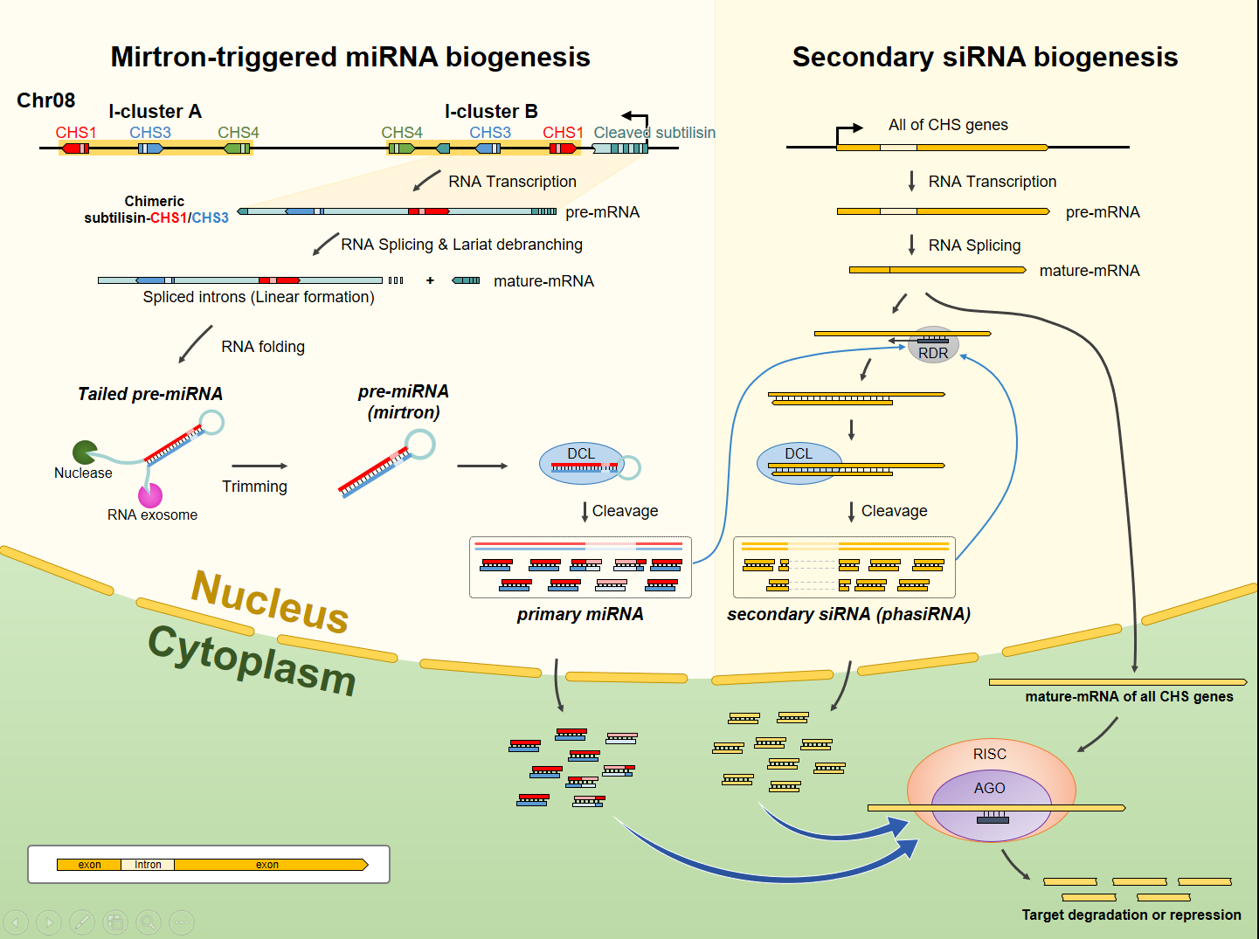
Mirtron-triggered gene silencing mechanism
21/28

Slide 22
그 외 연구 성과
22/28

Slide 23
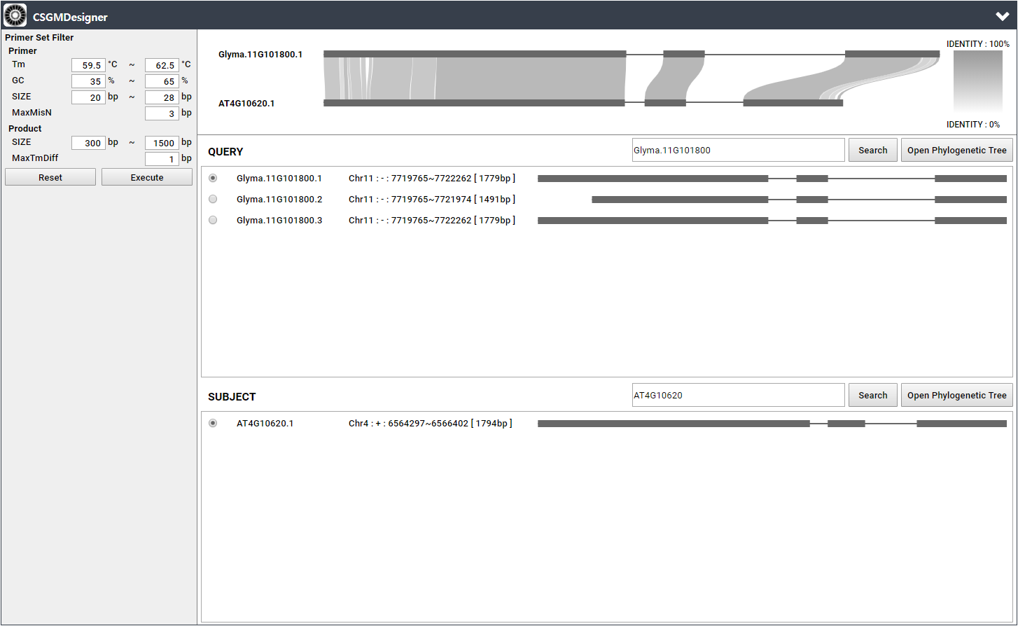
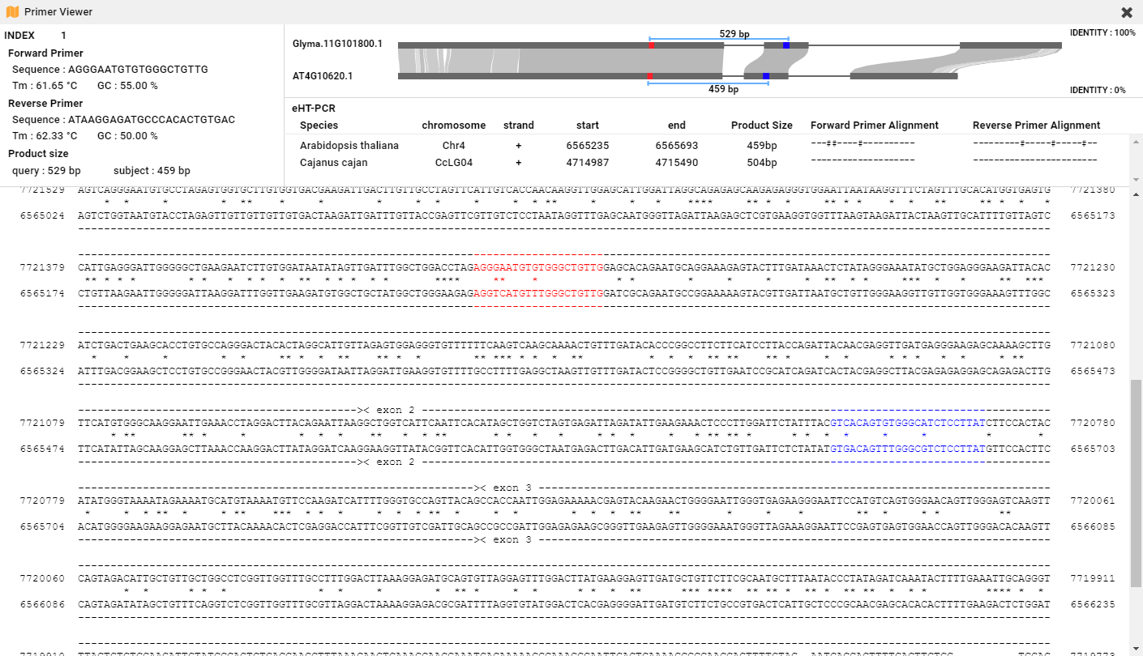
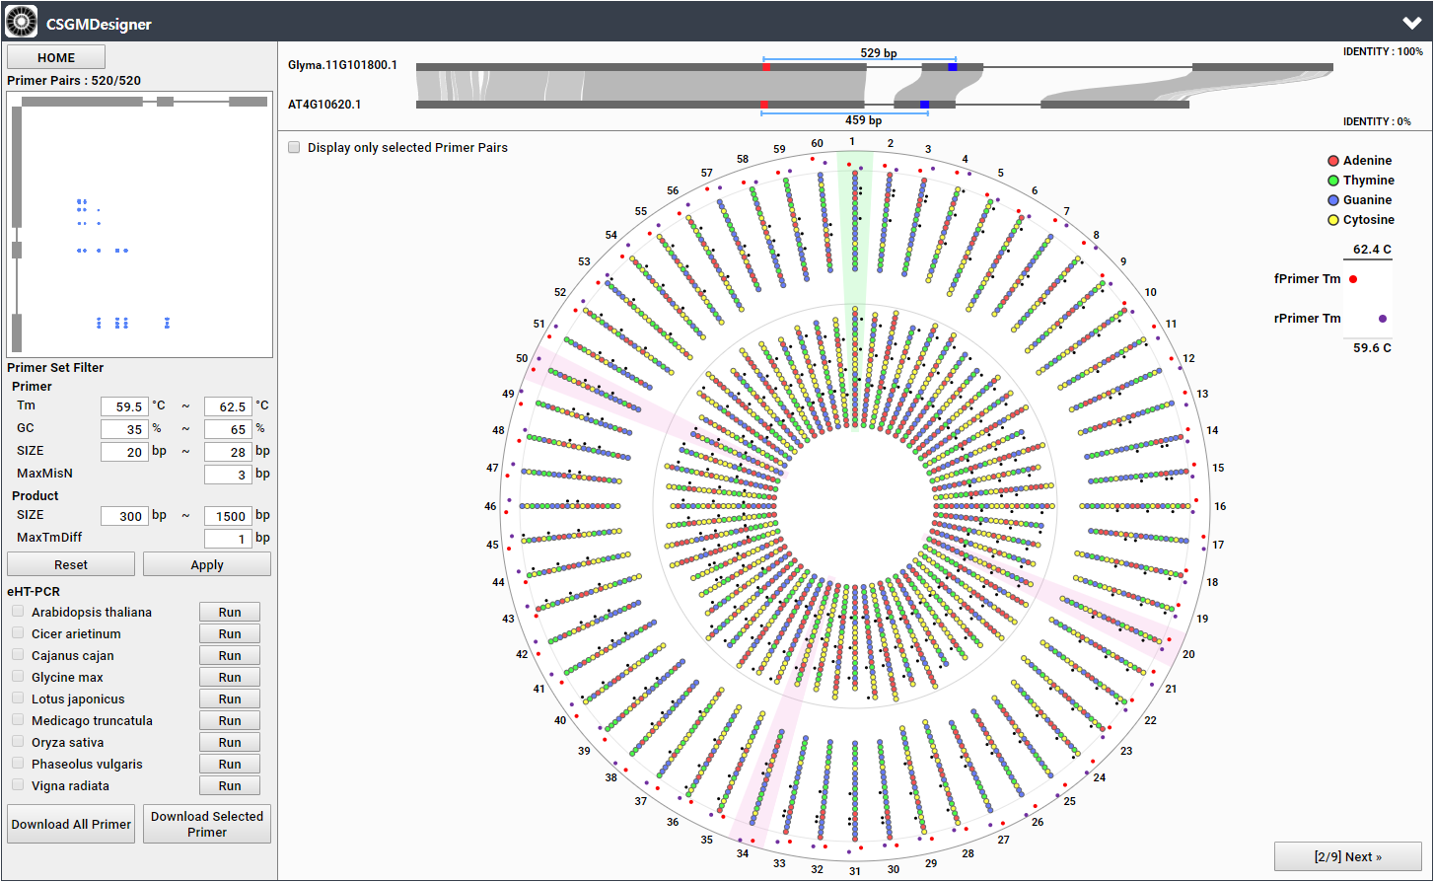
Automatic marker design program
(Cross-Species Genic Marker Designer)
Automatic marker development program linked with ortholog DB
An intuitive graphical interface facilitate user-friendly primer selection
Primer Viewer
Circular Viewer
23/28

Slide 24
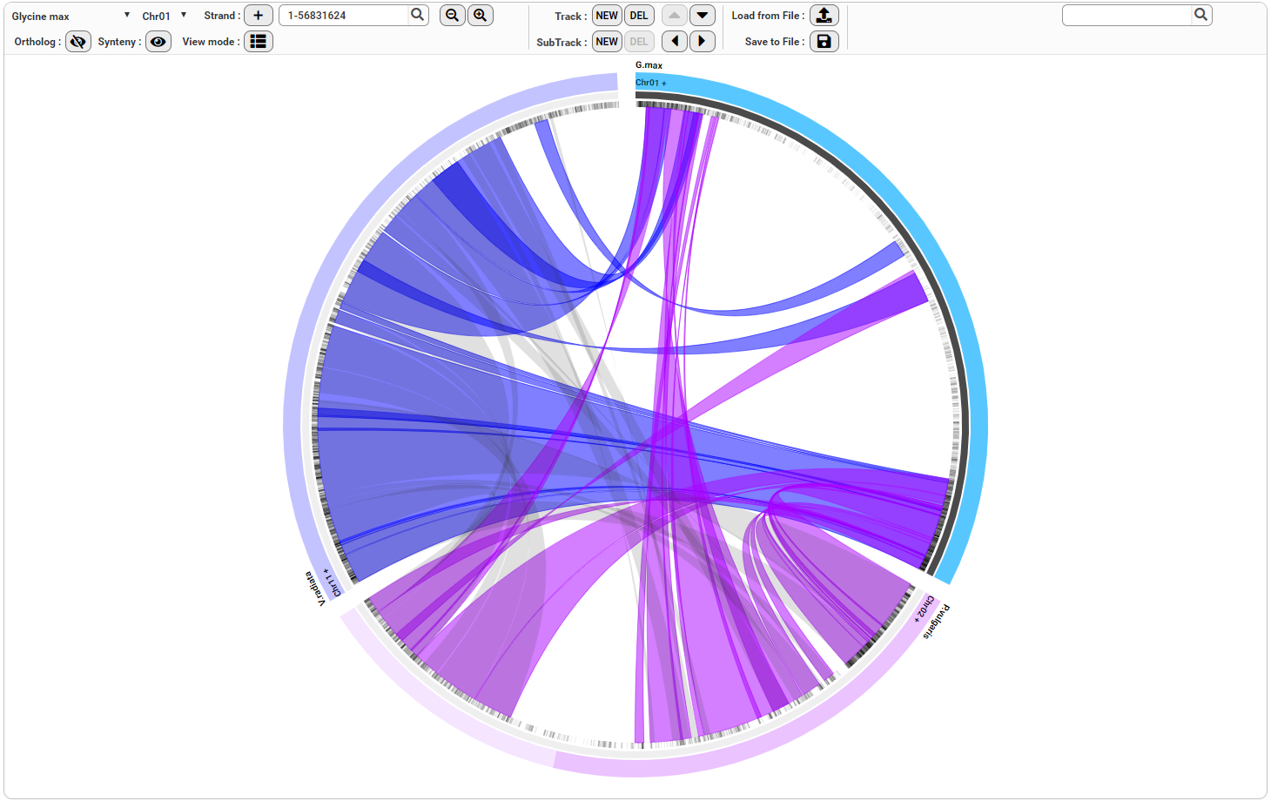
Comparative Genome Browser
Circular view mode
24/28

Slide 25
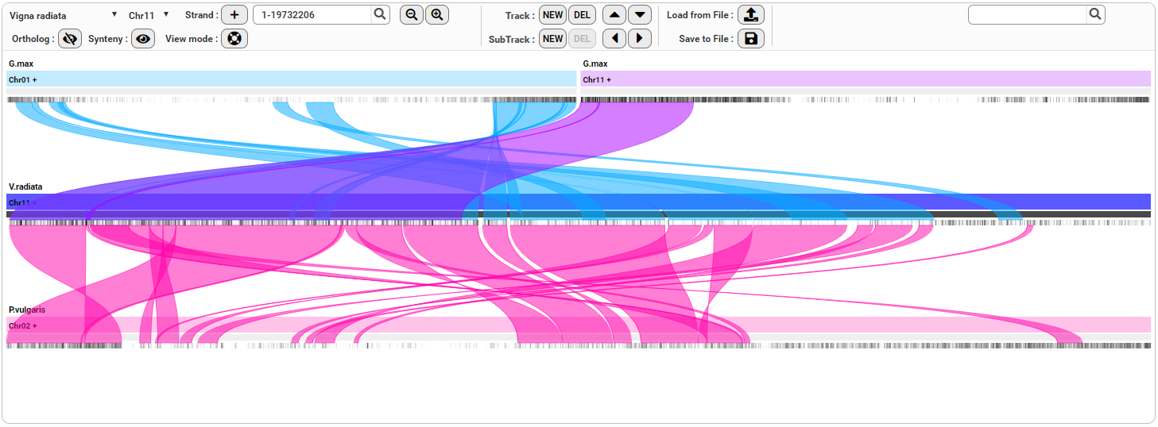
Comparative Genome Browser
Stack view mode
25/28

Slide 26
향후 계획
농업유전자원 유전체정보 관리체계 개선연구
표준유전체 해독 작물에 대한 마커평가정보 수집·관리 표준 개발 및 DB 구조 설계
표준유전체 정보와 DNA stock 정보 간 연계 표준 개발 및 DB 구조 설계
표준유전체 정보와 DNA profile 정보 간 연계 표준 개발 및 DB 구조 설계
유전체 정보 고도화 시스템 도입 및 NGS 분석 지원
유전체 빅데이터 인프라 유지보수
다부처유전체사업 NGS 기반 염기서열 생산 및 분석 및 지원
농생명 다차원 정보 관리 및 공유 체계 구축
다차원 정보 활용 시스템 구축
품목별 유전체 DB 구축 - 국내 주요작물 3품목
농생명 다차원 정보 관리 및 공유 체계 구축
26/28

Slide 27
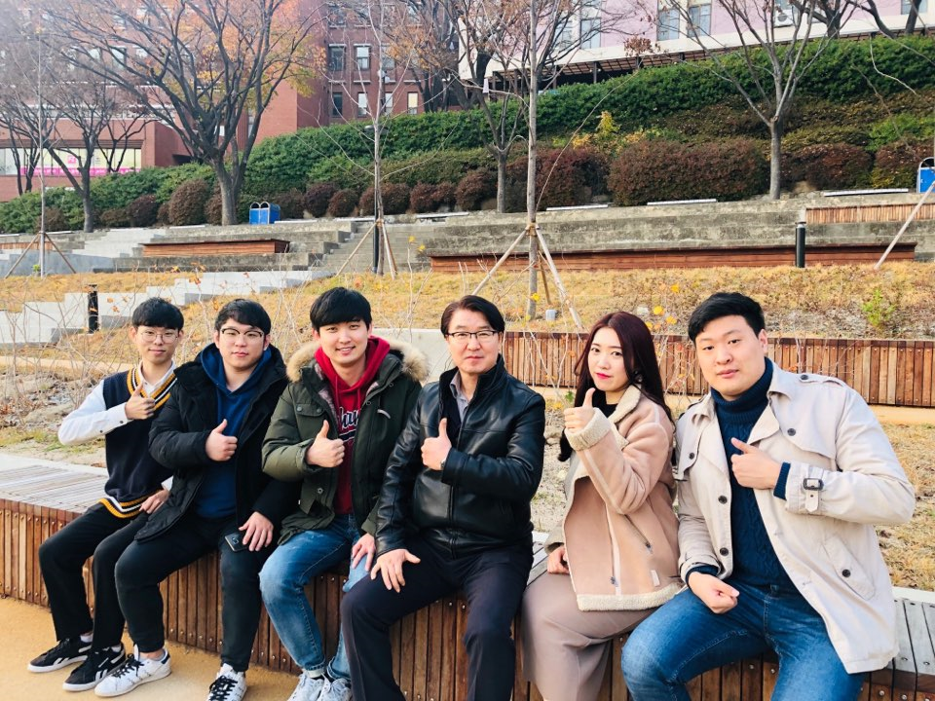



Acknowledgement
Plant Genomics/Bioinformatics Laboratory
Dong-A University
Prof. Do-Hoon Kim
Prof. Young-Soo Chung
Prof. Jae-Sung Nam
Prof. Gyung-Tae Kim
Prof. Ho-Won Jung
Prof. Jae-Bok Heo
Funding
KOBIC
Dr. Ryan W. Kim
RDA
Dr. Man-Soo Choi
Prof. Hong-kyu Choi, Jin-hyun Kim, Joo-seok Park, Min-gyun Jung, Yo-ram Choi, Yeong-il Jeong
27/28

Slide 28
경청해주셔서 감사합니다
(Q&A)
28/28

